Slide 1

Vivado Setup Tutorial
By Layth Jacob Sattam

Slide 2

https://www.xilinx.com/support/download.html

Slide 3
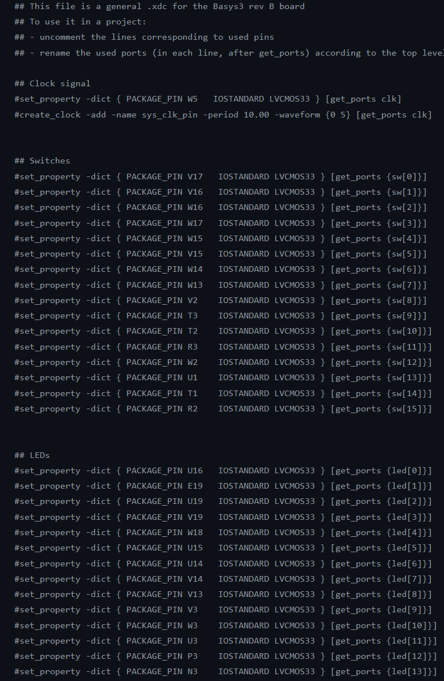
https://github.com/Digilent/digilent-xdc/blob/master/Basys-3-Master.xdc

Slide 4
To Design:
!A &
Cnt == 0xFF
A
A
0
1
2
3
Input(s):
clk, 1’b
A, 1’b
Output:
led, 8’b
Variables:
Cnt, 8’b
Led = 0xFF
Cnt = 0x00
Led = 0
Led = Cnt
Cnt += 1
Led = 0x55
!A

